Slide 1
Fitness Management System
Build on Microsoft .NET Framework 4.0 technology
Progress report as of 15 Maret 2012

Slide 2
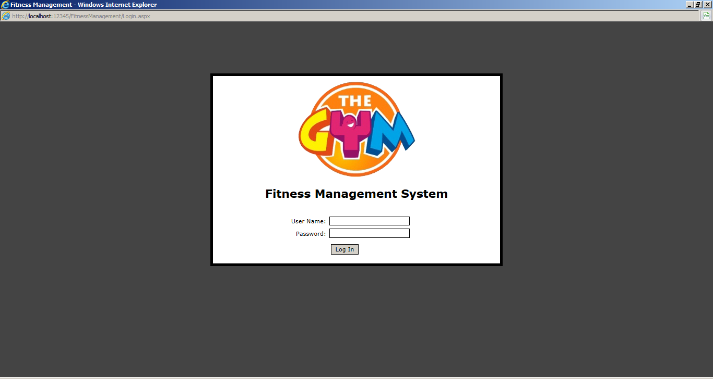
Log in Screen

Slide 3
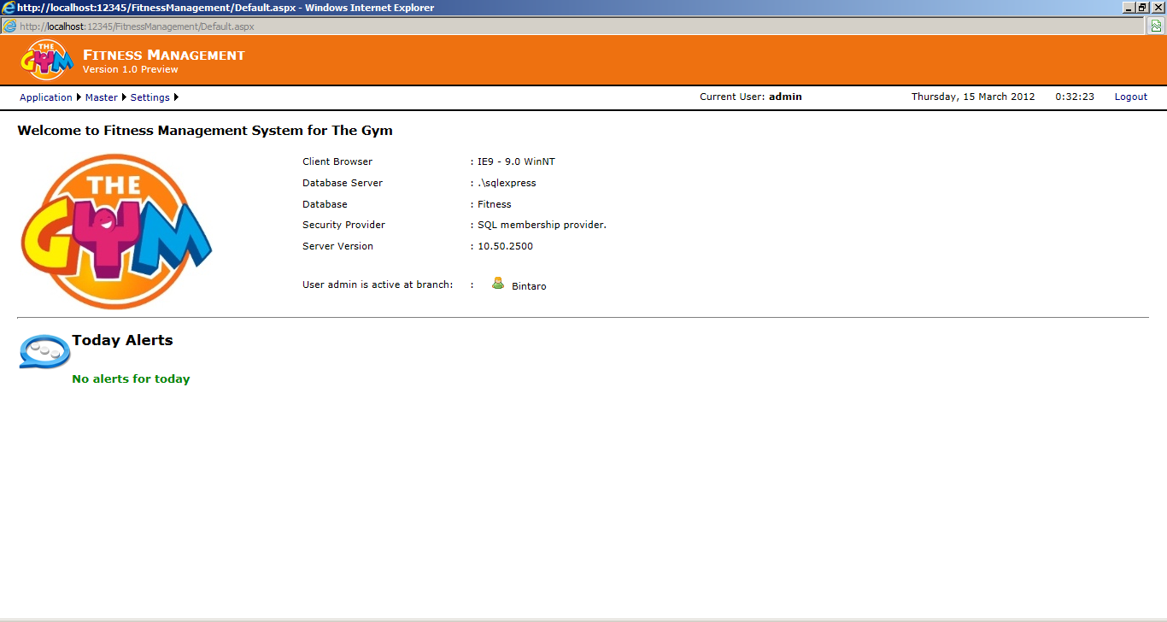
Landing Page

Slide 4
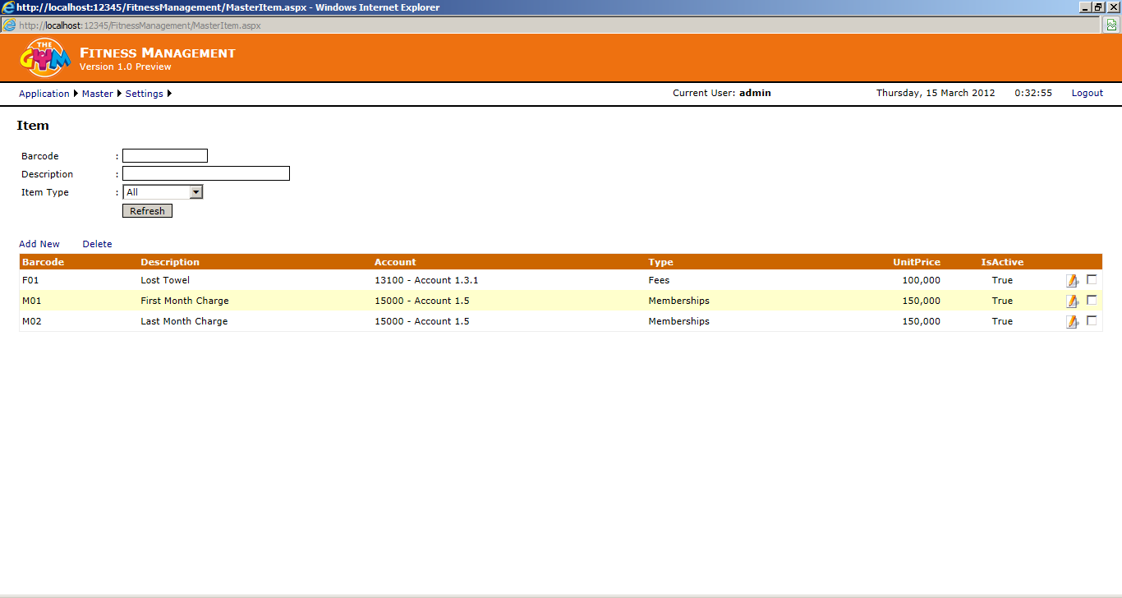
Master Data Screen

Slide 5
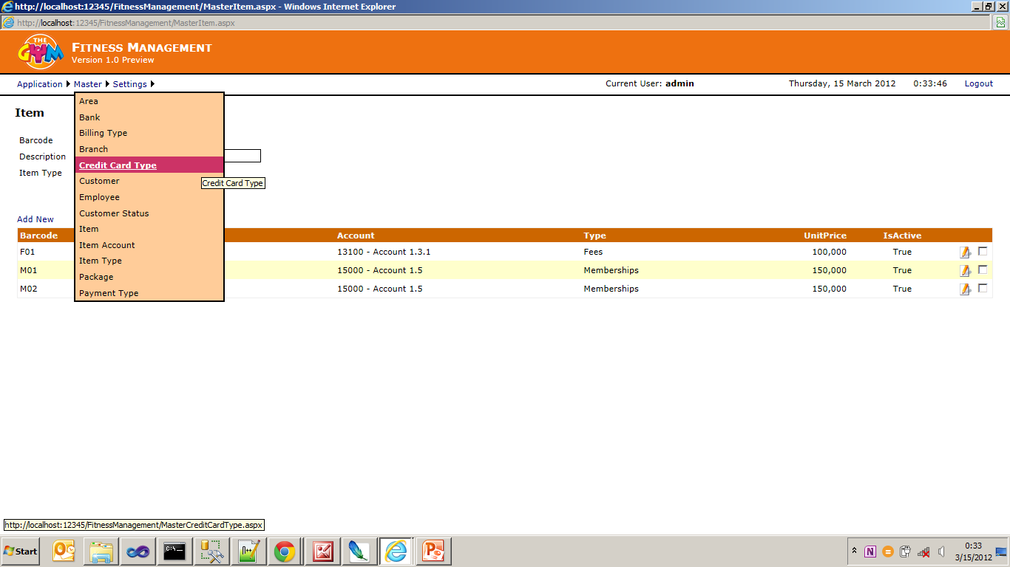
Master Menu

Slide 6
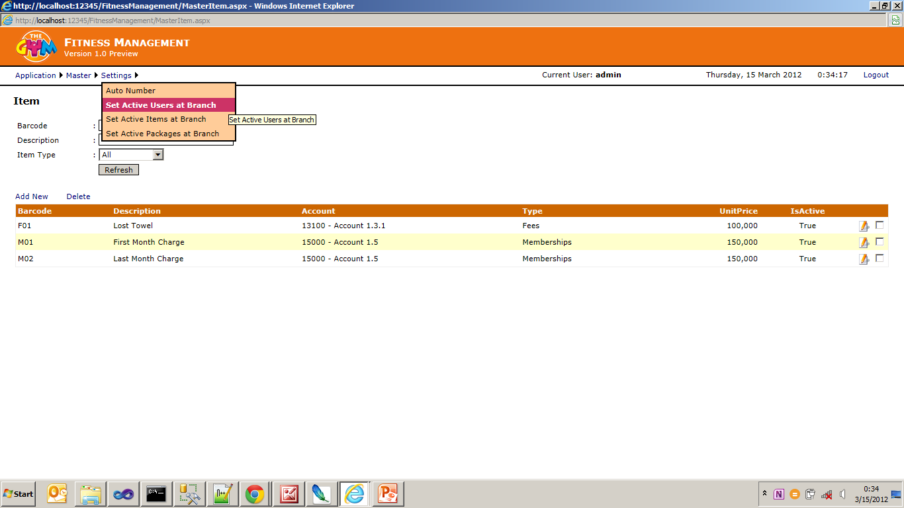
Settings Menu

Slide 7
Progress Report
Current week
Master Data Form:
Area
Bank
Billing type
Branch
Credit Card Type
Customer
Employee
Customer Status
Item
Item Account
Item Type
Package
Payment Type
Next week
Membership Transaction form :
Fresh member
Contract
Master data Customer
Existing member
Any purchasing items
Print Official Receipt

Slide 8
To be confirmed:
Auto number pattern (to be printed in Official Receipt)
Customer code pattern

